Slide 1

Breast Cancer Classification
Eva Kerry
BANA320

Slide 2
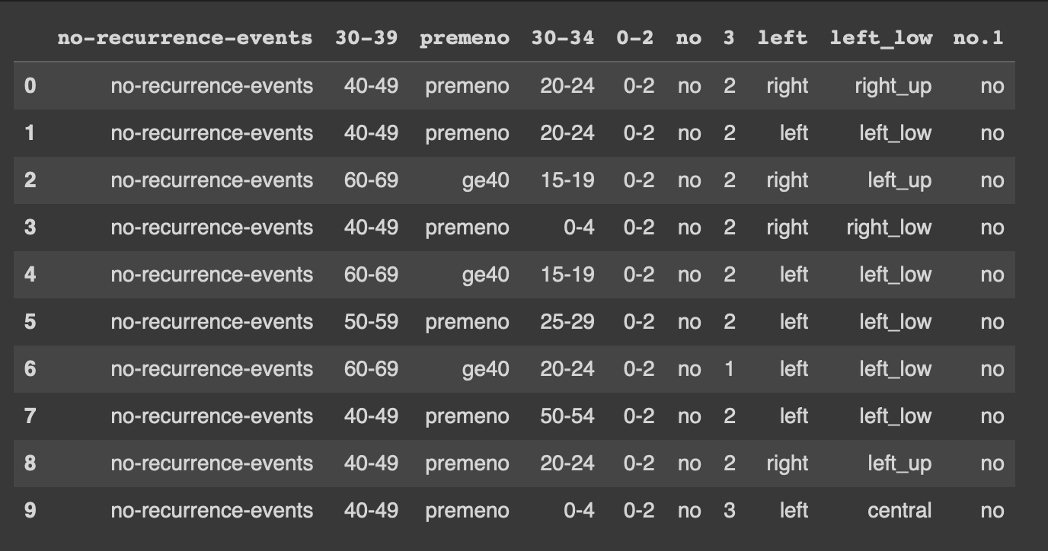
Data Set I Will be Analyzing

Slide 3
Problem Statement
Which of the select features contribute most to a recurrence event, and can a model accurately predict whether an event like this will occur?

Slide 4
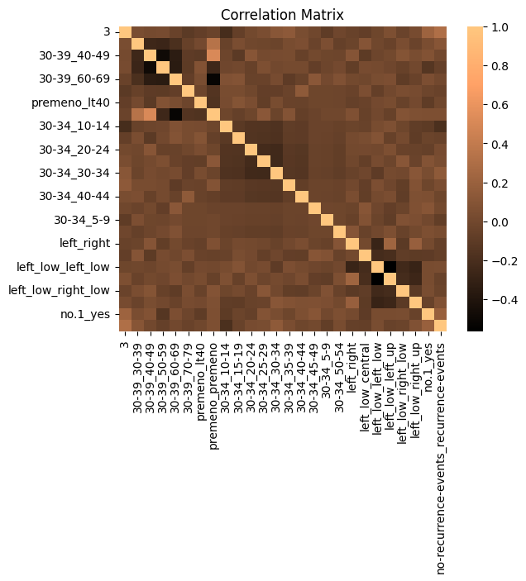
Problem Statement
Correlation Matrix
All features are about equal (correlation)

Slide 5

Step 1: Data Understanding
Variables:
Age (Independent)
Menopause (Independent)
Tumor Size (Independent)
Degree of Malignancy (Independent)
Breast (Independent)
Breast quadrant (Independent)
Irradiation (Independent)
Recurrence event (Dependent/Target)

Slide 6
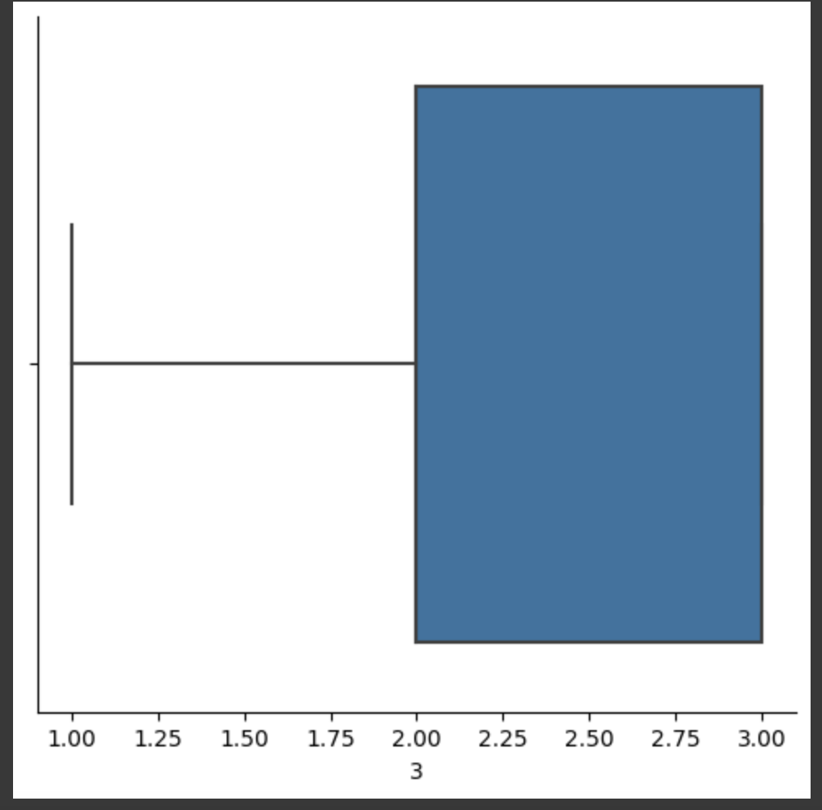
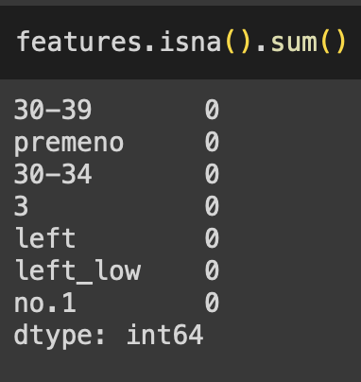
Step 2: Data Preprocessing/Prep
1. Check for missing values
2. Check for Outliers
3. Standardize numeric features
4. Create Dummy Variables
5. Check for Redundancy

Slide 7
Step 3: Model Building
3 Models
Decision Tree
KNN Model
Logistic Regression

Slide 8
Code for Models
Logistic Regression:
logmodel = LogisticRegression()
logmodel.fit(X_train, y_train)
KNN Model:
KNN = KNeighborsClassifier(n_neighbors=8)
KNN.fit(X_train, y_train)
Decision Tree:
decis_tree = DecisionTreeClassifier()
decis_tree.fit(X_train, y_train)

Slide 9
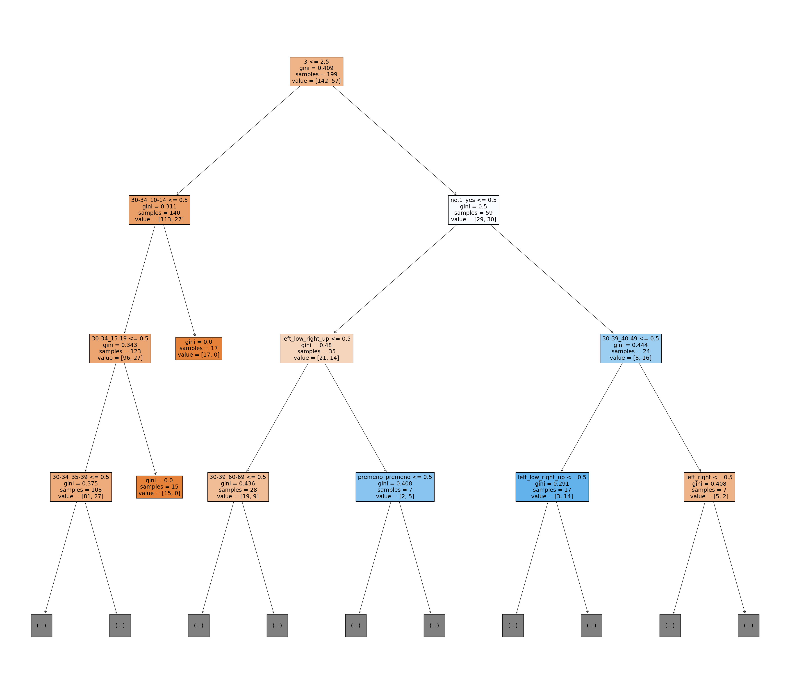

Slide 10
Step 4: Model Evaluation
Accuracy (about 70%)
Confusion Matrix
AUROC

Slide 11
Prediction
Woman aged 50-59
2nd degree of malignancy
Tumor has been irradiated
Premenopausal

Slide 12
Prediction
Logistic Regression:
No Recurrence
KNN:
No Recurrence
Decision Tree:
No Recurrence

Slide 13
Insights
1. Of the features provided, all contribute to a recurrence event equally.
2. All 3 models were able to predict with relative accuracy whether or not a recurrence event will occur.

